Slide 1


Rodrigo Antúnez
17/6/2024

Slide 2

Outline
Executive Summary
Introduction
Methodology
Annotation
Results
Conclusion
Appendix

Slide 3
Executive Summary
In the follow capstone project we will use some machine learning algorithms to predict if the SpaceX Falcon 9 can successfully land.
The main steps followed in this project include:
Data collection, wrangling and formatting.
Exploratory data analysis.
Interactive data visualization.
Machine learning prediction.
We can summarize that our graphics show that exists a correlation in the features of the rocket launches and the outcome of the launches.

Slide 4
Introduction
The main idea of the project is to predict if the SpaceX Falcon 9 first stage will land successfully. SpaceX advertises Falcon 9 rocket launches on its website with a cost of 62 million dollars; other providers cost upwards of 165 million dollars each, much of the savings is because SpaceX can reuse the first stage. Therefore, if we can determine if the first stage will land, we can determine the cost of a launch.
The main question that we are trying to answer is, through a set of features of the SpaceX Falcon 9 rocket which include it payload mass, orbit type, launch site, landing pad, etc. ¿The first stage of the Falcon 9 land will be successfully?

Slide 5

Section 1

Slide 6
Methodology
Executive Summary
Data collection methodology:
Data collection via a request to the SpaceX API - Web Scraping.
Perform data wrangling
Data wrangling and elimination of missing values
Perform exploratory data analysis (EDA) using visualization and SQL
Perform interactive visual analytics using Folium and Plotly Dash
Perform predictive analysis using classification models
Build, tune and evaluation of classification models

Slide 7
Annotation
The URLs to each notebook are found as hyperlinks on their corresponding slide. If you have any problems accessing them, you can find in the appendix the URL to access the repository where all the notebooks are located.

Slide 8
Data Collection
Data collection process involved a combination of API request from the SpaceX API and web scraping data from a SpaceX Wikipedia page.
The next slide will show more about the sequence of processing the data from SpaceX API and the sequence of processing the data from web scraping.
Also, the slides will include some pictures for a visualization of the results.

Slide 9
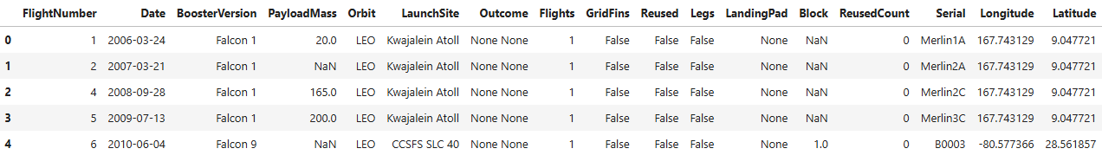
Data Collection – SpaceX API
The API used is the following https://api.spacexdata.com/v4/rockets/
The API provides data about different types of rocket launches done by SpaceX. Therefore the data is filtered to only include Falcon 9 launches.
Missing values in the data were treated.
Notebook on GitHub

Slide 10
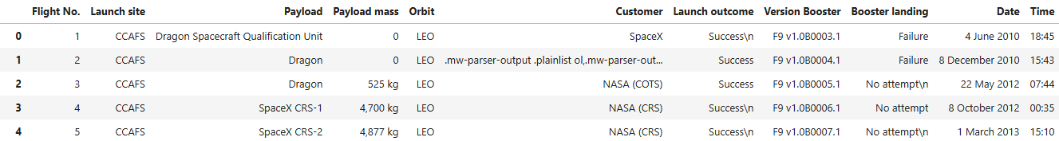
Data Collection - Scraping
The data was scraped from https://en.wikipedia.org/w/index.php?title=List_of_Falcon_9_and_Falcon_Heavy_launches&oldid=1027686922
The website contains data only about the Falcon 9 launches.
Notebook on GitHub

Slide 11
Data Wrangling
The data is processed to ensure that are no missing entries and categorical features are encoded using one-hot encoding.
An extra column called “Class” is also added to the data frame. The column contains 0 if a given launch is failed and 1 if the launch is successful.
Notebook on GitHub

Slide 12
EDA with Data Visualization
Were performed exploratory data analysis on variables flight number, payload mass, launch site, orbit, class and year.
Scatter plots, line charts, and bar plots were used to compare the relationship between the different variables to decide if exist some relationship so that they could be used in the training of the machine learning model.
Notebook on GitHub

Slide 13
EDA with SQL
The SQL queries performed are the following:
Display the names of the unique launch sites in the space mission
Display 5 records where launch sites begin with the string 'CCA’
Display the total payload mass carried by boosters launched by NASA (CRS)
Display average payload mass carried by booster version F9 v1.1
List the date when the first successful landing outcome in ground pad was achieved.
List the names of the boosters which have success in drone ship and have payload mass greater than 4000 but less than 6000
List the total number of successful and failure mission outcomes
List the names of the booster_versions which have carried the maximum payload mass. Use a subquery
List the records which will display the month names, failure landing_outcomes in drone ship, booster versions, launch_site for the months in year 2015.
Rank the count of landing outcomes (such as Failure (drone ship) or Success (ground pad)) between the date 2010-06-04 and 2017-03-20, in descending order.
Notebook on GitHub

Slide 14
Build an Interactive Map with Folium
Folium maps mark Launch sites, successful and unsuccessful landings and a proximity example to key locations how can be the railway, highway, coast, city and so on.
This allow us to understand where launch sites may be located and why. Also this give us a visualization of the successful landings relative to the location.
Notebook on GitHub

Slide 15
Build a Dashboard with Plotly Dash
Dashboard with Plotly contains a pie chart and a scatterplot which allow us to visualize the total success launches from each launch site and the correlation between payload mass and mission outcome for each launch site.
Those plots are utilized to generate an interactive site where we can toggle the input using a dropdown menu and a range slider.
Python file on GitHub

Slide 16
Predictive Analysis (Classification)
The machine learning prediction phase was carried out taking into account the following steps:
Data standardization
Data split (train – test)
Creation of machine learning model:
LR (Logistic Regression)
SVM (Support Vector Machine)
Tree (Decision Tree Classifier)
KNN (K Nearest Neighbors)
Model fit with train data
Search of best combination for each model
Evaluation of the models
Notebook on GitHub

Slide 17
Results
Exploratory data analysis results
Interactive analytics demo in screenshots
Predictive analysis results

Slide 18

Section 2

Slide 19
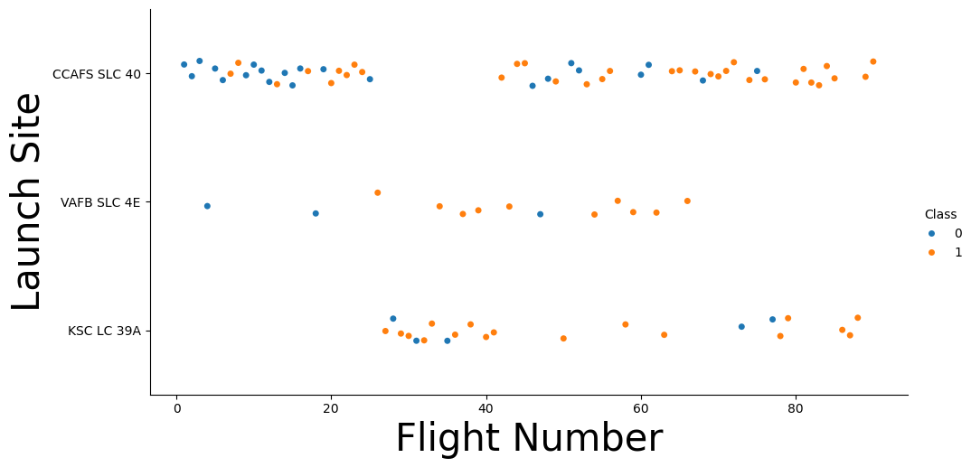
Flight Number vs. Launch Site
The scatter plot suggest that CCAFS SLC 40 appears to be the main launch site according to the volume of launch.

Slide 20
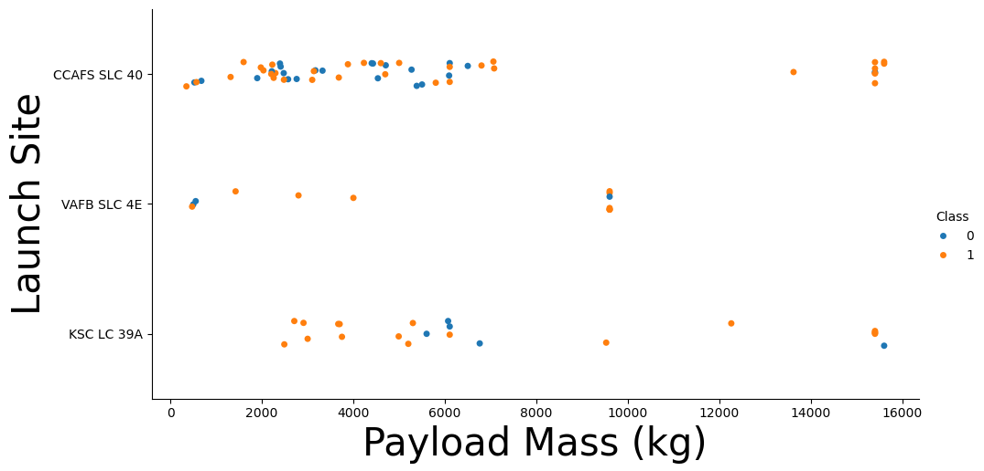
Payload vs. Launch Site
The scatter plot suggests that for the VAFB-SLC launch site there are no rockets launched for heavy payload mass (greater than 10000).

Slide 21
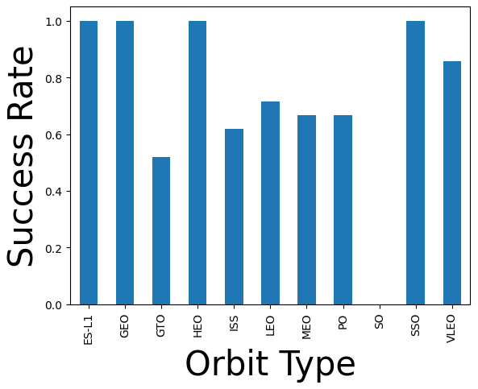
Success Rate vs. Orbit Type
From the scatter plot we can address that ES-L1, GEO, HEO and SSO orbit have a successful rate of the 100%. Also, is possible to address that the orbit SO have a 0% successful rate.

Slide 22
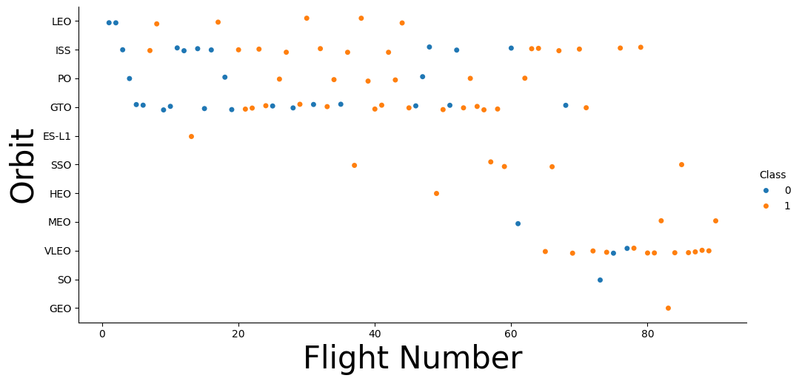
Flight Number vs. Orbit Type
The scatter plot suggests that in the LEO orbit the success appears to be related to the number of flights; on the other hand, there seems to be no relationship between flight number when in GTO orbit.

Slide 23
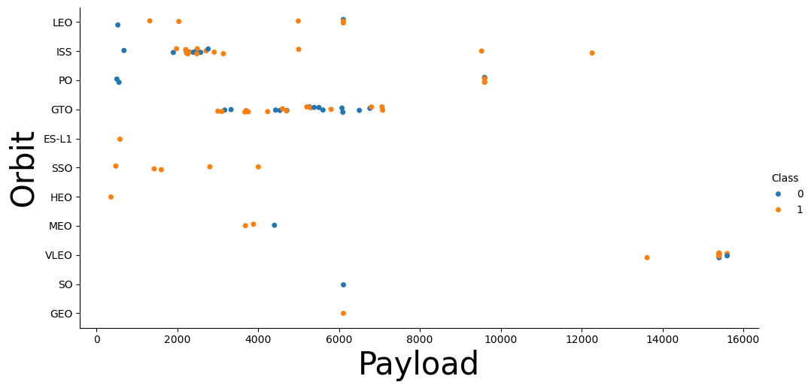
Payload vs. Orbit Type
From the scatter plot we can address that with heavy payloads the successful landing or positive landing rate are more for LEO and ISS. However for GTO we cannot distinguish this well as both positive landing rate and negative landing (unsuccessful mission) are both there here.

Slide 24
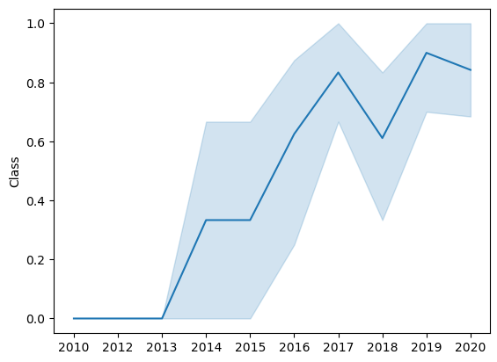
Launch Success Yearly Trend
The scatter plot show that the success rate since 2013 kept increasing till 2020.

Slide 25
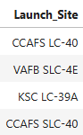
All Launch Site Names
The query result present all the launch sites names:
CCAFS LC-40
VAFB SLC-4E
KSC LC-39A
CCAFS SLC-40

Slide 26
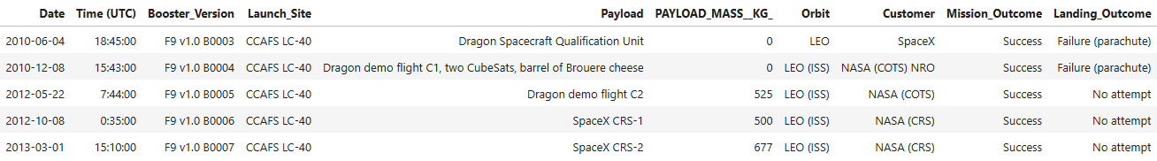
Launch Site Names Begin with 'CCA'
First 5 records where the launch site begin with `CCA`

Slide 27
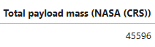
Total Payload Mass
This query result present the sum of the total payload mass in kg where NASA was the customer.

Slide 28
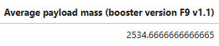
Average Payload Mass by F9 v1.1
This query result present the average payload mass or launches which used booster version F9 v1.1

Slide 29
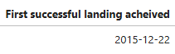
First Successful Ground Landing Date
Bellow we can see the query result for the first successful landing achieved.

Slide 30
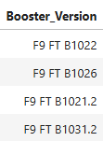
Successful Drone Ship Landing with Payload between 4000 and 6000
The query return the four booster versions that had successful drone ship landings and a payload mass between 4000 and 6000.

Slide 31
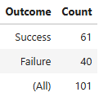
Total Number of Successful and Failure Mission Outcomes
This query returns a count of each mission outcome, including success and failure both. Also the query include the sum of both outcomes.

Slide 32
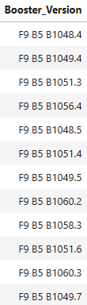
Boosters Carried Maximum Payload
This query returns the booster versions that carried the highest payload mass.

Slide 33
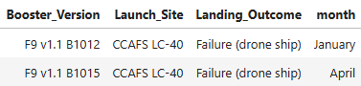
2015 Launch Records
The follow query result present the list of the failed landing outcomes in drone ship, their booster versions, and launch site names for in year 2015.

Slide 34
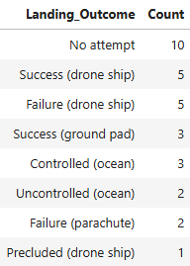
Rank Landing Outcomes Between 2010-06-04 and 2017-03-20
This query returns the rank count of landing outcomes (such as Failure (drone ship) or Success (ground pad)) between the date 2010-06-04 and 2017-03-20, in descending order.

Slide 35

Section 3

Slide 36
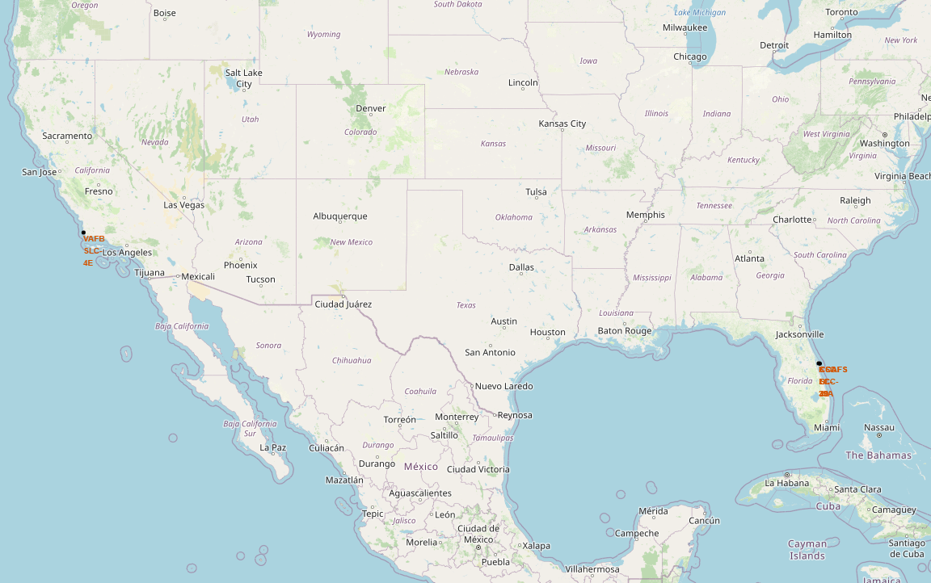
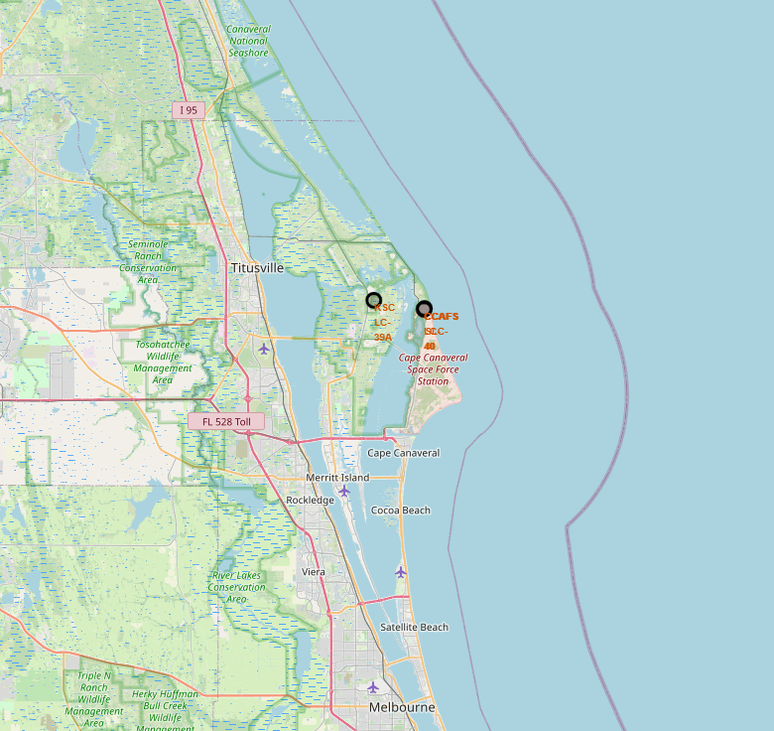
Launch Site Locations
The left map shows all launch sites in the US map. In other hand, the right map shows the specifics launch sites in Florida.

Slide 37
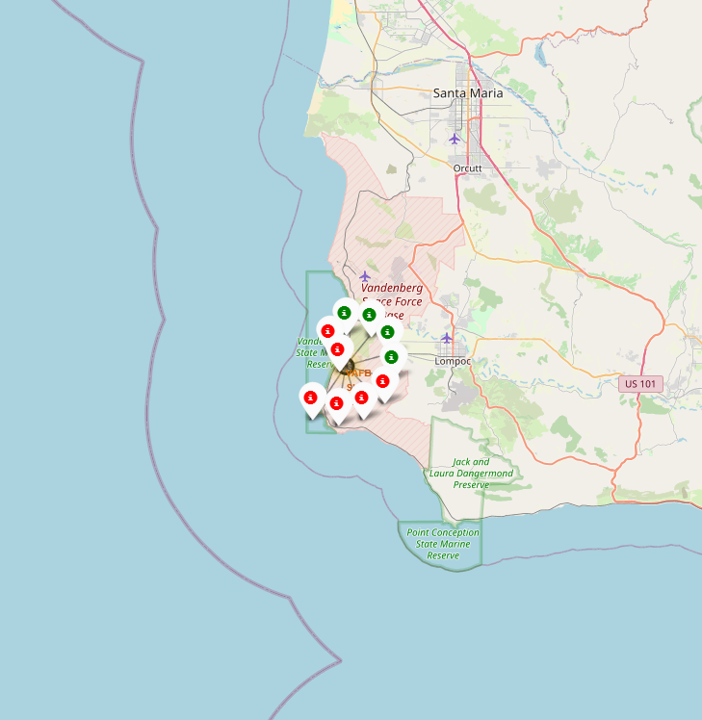
Launch Markers
Clusters can be clicked on to display each successful landing or failed landing. In the picture we can see that VAFB SLC-4E have 4 successful landings and 6 failed landings.

Slide 38
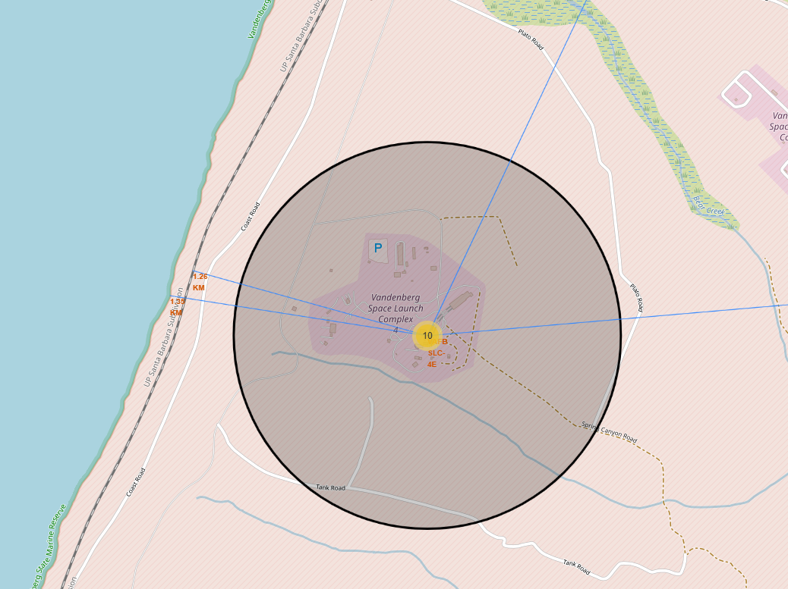
Locations Proximities
The picture shows the distance between the VAFB SLC-4E launch site and the nearest coastline. From this we can address that the launch sites are to nearest to the coastlines.

Slide 39

Section 4

Slide 40
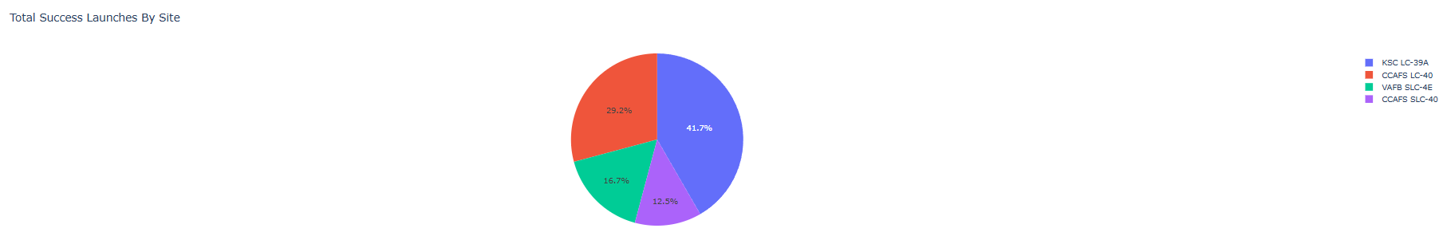
Successful Launches Across Launch Sites
This distribution shows the successful landings across all launch sites. We can infer that the KSC LC-39A have the majority of the successful landings. VAFB SLC-4E and CCAFS SLC-40 share an almost equal percentage of successful landings.

Slide 41
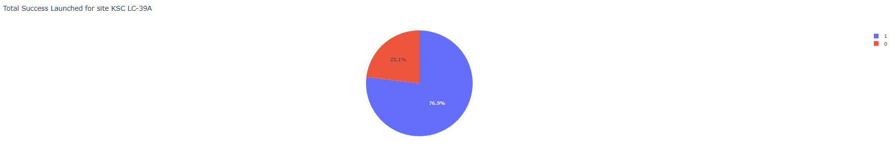
Highest Success Rate Launch Site
The picture below shows that the KSC LC-39A has the highest success rate.

Slide 42
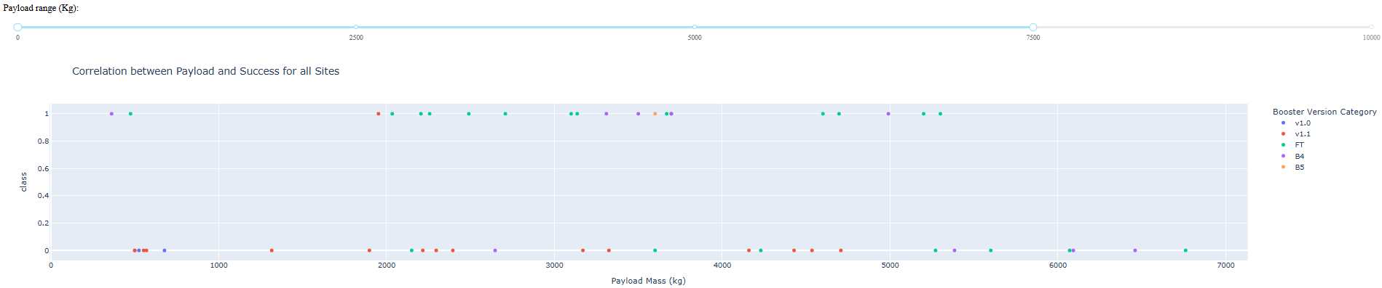
Payload Mass vs. Launch Outcome for All Sites
The Dashboard shows what occurs when you select all the launch sites and a Payload range between 0 and 7500.

Slide 43

Section 5

Slide 44
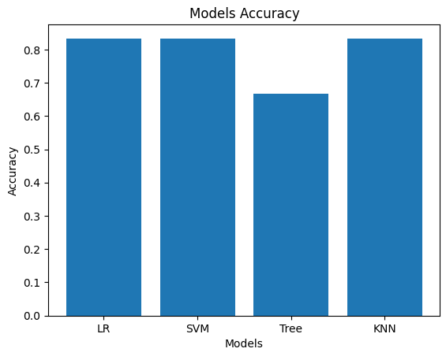
Classification Accuracy
In essence, the models have almost exactly the same precision (83.33%), except for the decision tree classifier (72.23%). We can say that is necessary more data to determine which is the best model.

Slide 45
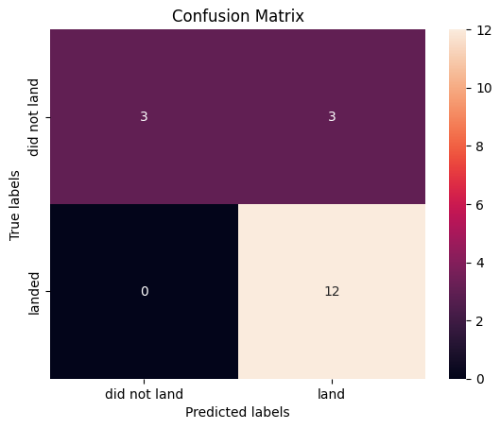
Confusion Matrix
Since most models yielded the same precision, the confusion matrix is ​​largely the same across all models.
The models predicted 12 successful landings when the true label was successful landing.
The models predicted 3 unsuccessful landings when the true label was unsuccessful landing.
The models predicted 3 successful landings when the true label was unsuccessful landings.
Our models over predict successful landings.

Slide 46
Conclusions
This project was carried out with the main idea of ​​trying to predict if the first stage of a given Falcon 9 launch could work, with the intention of determining the cost of the launch.
Some features of the Falcon 9 launch, such as the payload mass, the launch location or the type of orbit, may affect the outcome of the mission in some way.
The machine learning algorithms used to study the Falcon 9 launch allowed us to create predictive models in order to determine the final result of a Falcon 9 launch.
The predictive model produced by Logistic Regression, Supportive Vector Machine, and K Nearest Neighbors performed the best among the 4 machine learning algorithms employed.

Slide 47

Appendix
You can access to the GitHub repository from the following URL
atwncito/Capstone-final-project: Capstone final project from Coursera (github.com)
Special thanks to Coursera
platform for giving the course c:

Slide 48


